Slide 1
TOPIC 4 ICT FOR EXPLORATORY LEARNING

Slide 2
Introduction
Exploratory learning can be defined as an approach to teaching and learning that encourages learners to examine and investigate new material with the purpose of discovering relationships between existing background knowledge and unfamiliar content and concepts.

Slide 3
As children explore and investigate, they are making cognitive connections and stretching their minds to make sense of what they are observing.

Slide 4
ICT can support all areas of learning, adding a different approach to learning, it adds animation and sound and allows children to explore all possibilities

Slide 5
PRINCIPLES of EXPLORATORY LEARNING
Learners can and should take control of their own learning
Knowledge is rich and multidimensional
Learners approach the learning task in very diverse ways
It is possible for learning to feel natural, it does not have to be forced or contrived.

Slide 6
Play and Exploration

Slide 7
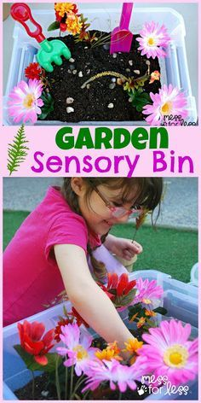
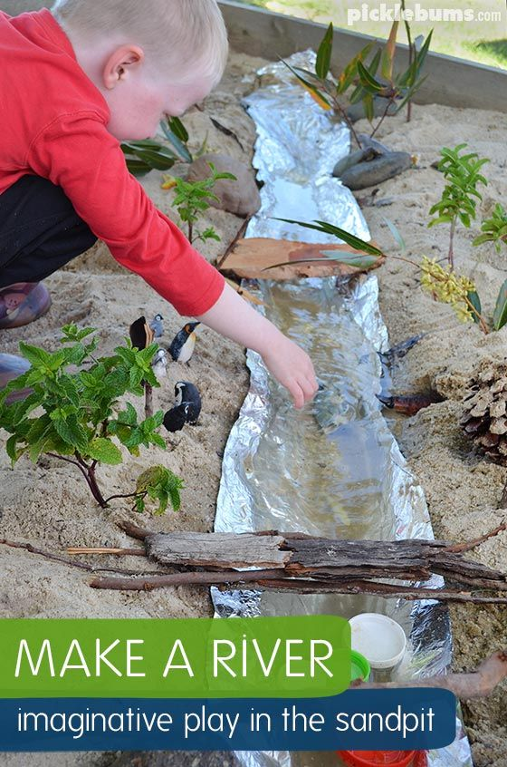
Examples of play and exploration activities

Slide 8
Lets go out and explore the environment

Slide 9
All you need to do is :
Create a group of 2
Decide a theme
Explore the environment
Capture pictures and record videos
Do a presentation
Draw a few pictures

Slide 10
Any question?

