Slide 1
ICT AND INTERNET USAGE IN EARLY CHILDHOOD EDUCATION

Slide 2
LEARNING OUTCOMES
IN THE END OF THIS TOPIC, STUDENT SHOULD BE ABLE TO
Technology and children
Ways children can benefit from technology and active screen time
Explain the advantages of internet usage in ECE
Explain the disadvantages of internet usage in ECE

Slide 3
Technology and Children

Slide 4
The amount of technology used by children.
Children spend an average of seven hours a day using screen media, including one to two hours a day for those under age two. Ninety percent of parents report that children below age two watch some form of electronic media.

Slide 5
The amount of technology used by children.
While some studies report children aged two to four average two hours a day of screen time (Ride out, 2011), other research finds children aged two to five years spend more than 32 hours a week in front of a screen (McDonough, 2009).

Slide 6
“For many children, this is more time than they spend in any other activity except sleeping” (Levin, 2013, p. 13).

Slide 7
The amount of technology used by children.
Fifty-two percent of children aged birth to eight have access to a smart phone, tablet, or similar electronic device (Guernsey, 2012).

Slide 8
How technology is used by children.
Most parents admit to using screen time as a distraction, peace keeper, or babysitter while adults do household chores (AAP, 2011).
Technology is only effective when teachers mediate its use with the same developmentally appropriate practices they apply to any other type of learning experience (Plowman & Stephen, 2005; 2007).

Slide 9
Most research has documented
the negative effects of media use by young children

Slide 10
The negative effects of technology use by children.
For children below age two, media exposure has been associated with language delays (Linebarger & Walker, 2005).
For preschool and school-aged children, media use has been associated with physical, behavioral, and mental health problems, including obesity, poor sleep habits, aggressive behavior, and attention disorders (Nunez-Smith, Wolf, Huang, Emanuel, & Gross, 2008).

Slide 11
The negative effects of technology use by children.
The more time children under age five spend with media, the less they interact with others (siblings, parents, peers) and the less creative their play (Vandewater, Bickham, & Lee, 2006).

Slide 12
The negative effects of technology use by children.
For children aged one to three, background television reduces the amount of time they play and diminishes their focused attention when they do play (Schmidt, Pempek, Kirkorian, Lund, & Anderson, 2008).

Slide 13
The positive effects of technology use by children.
“Active, appropriate use of technology and media can support and extend traditional materials in valuable ways ... both cognitive and social” (NAEYC & The Fred Rogers Center, 2012, p. 7). For example, computers allow young children to manipulate shapes (mathematics) with greater dexterity than they can manage by hand and often promote collaborative (social) problem solving (Clements, 2002).

Slide 14
Ways kiddies can benefit from technology and active screen time

Slide 15
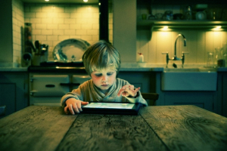
Better Hand-eye Coordination
This occurs when children visually follow an object on the screen and actively participate in the activity the application presents.
Hand-eye coordination is essential as children begin school when they learn how to use their hands and eyes while writing and drawing.
Notes:
This occurs when children visually follow an object on the screen and actively participate in the activity the application presents. Hand-eye coordination is essential as children begin school when they learn how to use their hands and eyes while writing and drawing.

Slide 16
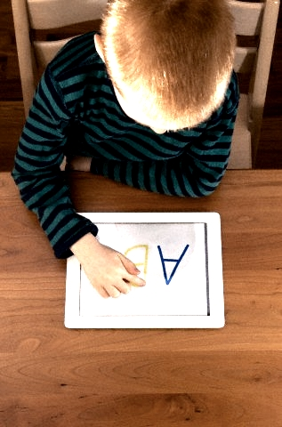
Improves Language Skills
Active screen time help children develop language skills.
By reading eBooks or accessing stories online, they learn new words and proper ways to pronounce them.
Notes:
Active screen time help children develop language skills. By reading eBooks or accessing stories online, they learn new words and proper ways to pronounce them.

Slide 17
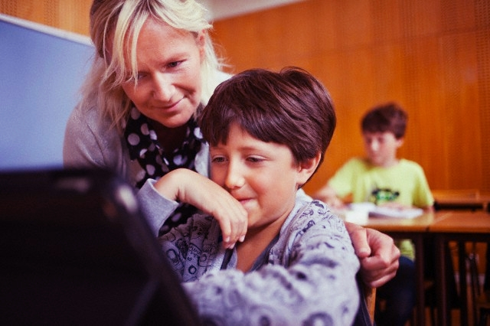
Promotes School Readiness and Cognitive Development
Many developmentally appropriate computer programs increase a child’s readiness to learn Reading and Math.
Technology may provide basic skills in which children must have competency in order to be successful in school; skills critical for children to then engage successfully in higher-order thinking and applied learning.
Notes:
Many developmentally appropriate computer programs increase a child’s readiness to learn Reading and Math. Technology may provide basic skills in which children must have competency in order to be successful in school; skills critical for children to then engage successfully in higher-order thinking and applied learning.

Slide 18
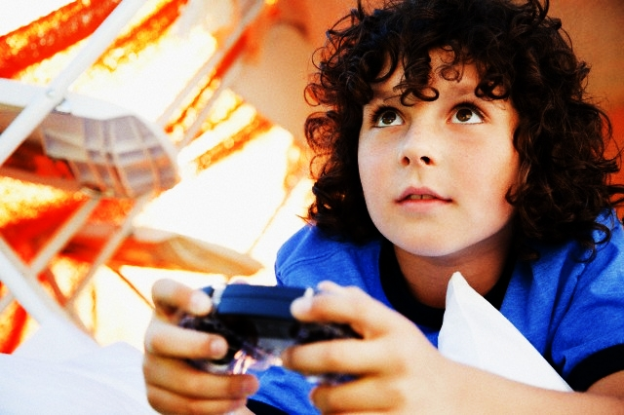
Higher Capacity for Visual Attention
Gaming and learning applications equip children to pay more attention to details in order to complete these activities
Notes:
Gaming and learning applications equip children to pay more attention to details in order to complete these activities

Slide 19
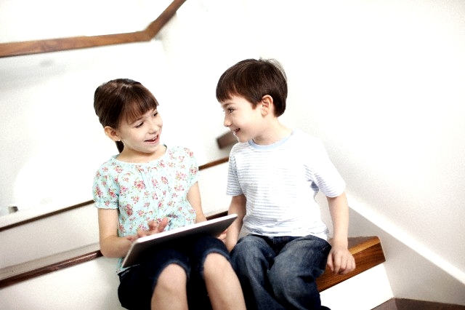
Enhances Social Interaction Skills
As children develop their language skills, they are able to absorb ideas that equip them with skills necessary in relating with other people.
When technology is used appropriately, technology can be used in collaboration with other people.
Notes:
As children develop their language skills, they are able to absorb ideas that equip them with skills necessary in relating with other people. When technology is used appropriately, technology can be used in collaboration with other people.

Slide 20
Increases Motivation to Complete Tasks
Many apps and computer activities are created to encourage children to complete a level in order to unlock the next level.
These learning games may help create a foundation for children to keep on trying and to overcome challenges even outside the screen setting.
Notes:
Many apps and computer activities are created to encourage children to complete a level in order to unlock the next level. These learning games may help create a foundation for children to keep on trying and to overcome challenges even outside the screen setting.

Slide 21
More Dynamic Spatial Skills
Games and educational content allow children to develop dynamic spatial skills through interactive screen time.
Through technology, they can learn how big a building may be compared to a cat; or how small an ant may be compared to a dog.
Such skills will then develop their understanding for the world around them.
Notes:
Games and educational content allow children to develop dynamic spatial skills through interactive screen time. Through technology, they can learn how big a building may be compared to a cat; or how small an ant may be compared to a dog. Such skills will then develop their understanding for the world around them.

Slide 22
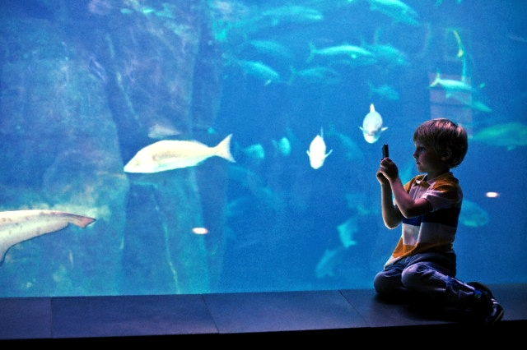
Expands Horizons
Technology exposes children to things they can’t see everyday.
With technology, children can access multimedia presentations of the different types of animals, or even see various places around the world.
Children then begin to understand that life is more than just the four walls of the home or classroom.
Notes:
Technology exposes children to things they can’t see everyday. With technology, your child can access multimedia presentations of the different types of animals, or even see various places around the world. Children then begin to understand that life is more than just the four walls of the home or classroom.

Slide 23
Advantages and Disadvantages of Internet

Slide 24
Advantages of Internet on children
Ability to do research from your home versus research libraries.
Information at various levels of study. Everything from scholarly articles to ones directed at children.
The internet provides the ability of emails. Free mail service to anyone in the country.
Notes:
Message boards where people can discuss ideas on any topic. Ability to get wide range of opinions. People can find others that have a similar interest in whatever they are interested in.

Slide 25
Advantages of Internet on children
Friendships connections have been made over the internet by people involved passion over similar interests.
Things such as Yahoo Answers and other sites where kids can have readily available help for homework.
Platform for products like SKYPE, which allow for holding a video conference with anyone in the world who also has access.

Slide 26
Disadvantages of Internet on children
There is a lot of wrong information on the internet. Anyone can post anything, and much of it is garbage.
There are predators that hang out on the internet waiting to get unsuspecting people in dangerous situations.
Some people are getting addicted to the internet and thus causing problems with their interactions of friends and loved ones.
Pornography that can get in the hands of young children too easily.

Slide 27
Disadvantages of Internet on children
Easy to waste a lot of time on the internet. You can start surfing, and then realize far more time has passed than you realized.
Internet and television together of added to the more sedentary lifestyles of people which further exacerbates the obesity problem.
Hackers can use the internet for identity theft.
Notes:
6) Internet has a lot of "cheater" sites. People can buy essays and pass them off as their own far more easily than they used to be able to do.
7) There are a lot of unscrupulous businesses that have sprung up on the internet to take advantage of people.
8) Hackers can create viruses that can get into your personal computer and ruin valuable data. 10) It can be quite depressing to be on the internet and realize just how uneducated so many people have become in today's society

Slide 28
THANKS!
Any questions?

