Slide 1
TOPIC 8: ISSUES OF MEDIA & TECHNOLOGY IN EARLY CHILDHOOD EDUCATION

Slide 2
INTRODUCTION
Information technology was introduced as schools for the purpose of assisting with teaching and learning
The Internet, has become a popular educational tool among educators and learners for its versatility
Internet related activities have made a place in the teenagers hobby lists and students have increasingly becoming adept at utilizing the Internet’s many interesting features – electronic mail, chat, online gaming, web browsing and many more
The pros and cons of the Internet are widely discussed and have become one of the most debated topics in the education system

Slide 3
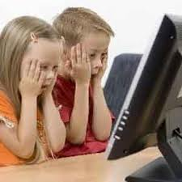
ISSUES
Internet addiction
Bad influence from online correspondence
Bad influence through illegal, immoral, criminal and other inappropriate contents
Lack of face-to-face social interaction
Facilitation of deception
Plagiarism
Budding hackers

Slide 4
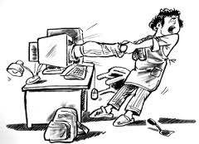
(1) INTERNET ADDICTION
People become addicted to the Internet when they have dissociated it from their face-to-face life
This phenomenon is very common among the “netizens”
Many Internet users have experiences drastic lifestyles changes in order to spend more time online which can be detrimental for young generations

Slide 5
(2) BAD INFLUENCE FROM ONLINE CORRESPONDENCE
It has become concern that young generations are exposed to destructive ideas through online communication
Terrifying possibility for the young befriending the wrong people through the Internet
“If you are concerned about your child joining the wrong social group at school, imagine the entire world of 400 million users having access to the curious mind of your child?”

Slide 6
(3) BAD INFLUENCE THROUGH ILLEGAL, IMMORAL, CRIMINAL AND OTHER INAPPROPRIARE CONTENTS
Being such an open and hard to control system, it is easy for anybody including youngsters to access these materials
Inappropriate content – variety of information resources available on the Internet that parents likely do not want their children looking at for the fear of the psychological effects by viewing this material repeatedly
Internet has been praised for making news and educational materials but also criticized for pornography, hate speech, defamatory statements and other materials that may find undesirable

Slide 7
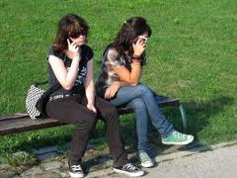
(4) LACK OF FACE-TO-FACE SOCIAL INTERACTION
Online communication is seen as detrimental to social skill development
The lack of social cues, inadequately supplemented by devices like emoticons, demands a level of complexity and care in communicative approach

Slide 8
(5) FACILITATION OF DECEPTION
Anonymity makes people feel lees vulnerable about opening up
The freedom of speech is exploited to the fullest as people can choose not to reveal their identities
When acting out hostile feelings, the anonymous does not have to take responsibility for those actions
People might even convince themselves that those behaviors “aren’t me at all”

Slide 9
(6) PLAGIARISM
The abundance of knowledge in the Internet has led to an increased number of “web cheaters” among students
Students can be tempted to simply implement a “cut, paste and excel” method for their assignments
The wealth of knowledge the Internet provides can only make it easier

Slide 10
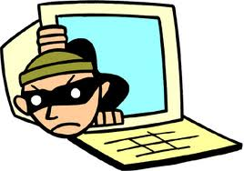
(7) BUDDING HACKERS
Many tech savvy teenagers find it amusing to be able to “hack” or interrupt existing network system
February 2000, online attack which lasted almost 5 days slowing down the Internet by 20% and crashing many of the world’s most popular e-commerce sites
This incident is by a teen hacker and he was using only a simple hacking tool download from the Internet

Slide 11
CURRICULUM & PARENTS
Parents should play the biggest role in handling any form of social problems faced by their children and problems resulting from the information revolution should be no exception
Very common today that parents simply leave the responsibility of overcoming social problems to the education systems, especially when it concerns the use of technology
Parents have the biggest concerns regarding the negative effects brought by the Internet to their children – yet most of them often appear to be poorly informed about their children’s Internet activities

Slide 12
CURRICULUM & PARENTS
Schools must consider involving parents in the students’ awareness programs on the Internet safety and responsibility
While the curriculum reform and technology solution may work at school, there is no guarantee the students will get the same guidance and protection at home
School still have to rely on parents to continue guiding their children

Slide 13
CURRICULUM & PARENTS
Many reasons that have led parents to rely on the education system to guide their children in embracing the technology:
Parents are too busy
Parents cannot afford the technology
Parents do not know the technology

Slide 14
(1) PARENTS ARE TOO BUSY
Main reasons for any type of social problems
The modern world has now made the responsibility to make ends meet priority in the households
Parents are too busy making a living to worry about what computers and the Internet can do to their children

Slide 15
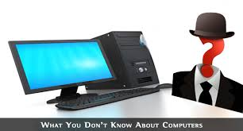
(2) PARENTS CANNOT AFFORD THE TECHNOLOGY
Usually the case for families who cannot afford to have computers and Internet at home
Cannot afford to have computers and Internet connections get their introduction and access to the Internet
In many researches, there is a big percentage gap on computer and Internet access availability between families of higher income and those of lower income
The school has become the only place their children can have access to the technology; therefore parents from a “no computer households” have no exposure to the technology

Slide 16
(3) PARENTS DO NOT KNOW TECHNOLOGY
Parents who are not exposed to computers cannot share the concept of IT with their children
Parents are also worried and afraid of the negative implications of the technology
Parents feel that they are not knowledgeable enough to teach their children about IT – they feel that the children know more than them and fear appearing uninformed before their children
Parents must be included in forming policies that is governing computer use at school and home
Teachers and parents must get together to draw guidelines and rules of the children’s Internet use

Slide 17
GOVERNMENT & PUBLIC INVOLVEMENT IN HELPING THE EDUCATION SYSTEM ADDRESSING THE ISSUES
Many researchers and literatures encourage for an educational response to the needs of addressing the social and ethical problems brought by the Internet
Young people are more prone to engage themselves in irresponsible Internet activities, therefore education system have a duty to educate the students about their responsibilities as cybercitizens
The time has come for education system to adopt strict technology policies which minimized the harmful effects to the young
It is vital that education system is adaptable and it is important that educators review their traditional educational practices to accommodate the society’s technological changes

Slide 18
GOVERNMENT & PUBLIC INVOLVEMENT IN HELPING THE EDUCATION SYSTEM ADDRESSING THE ISSUES
The governments and the public have steadily acknowledged the possible dangers the Internet may have on the young
There are also contributions from non-profit organizations to help educate children on Internet safety and responsibilities
The IT industries have also contributed through the research and development of technological solutions – filtering programs such as NetNanny and CyberPatrol as well as other auditing and monitoring tools which are widely used at schools as well as homes to block access to undesirable sites and monitor students’ Internet activities

Slide 19
THANK YOU

